Slide 1
Linear algebra:
Symmetric matrices and positive definiteness
主讲人：常万里

Slide 2

Reference
MIT 18.06 Linear Algebra
https://ocw.mit.edu/courses/mathematics/18-06-linear-algebra-spring-2010/
http://open.163.com/special/opencourse/daishu.html

Slide 3
Index
Symmetric matrices
Positive definite matrices

Slide 4
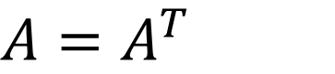
Symmetric matrices
$$A=A^{T}$$
Property:
For a symmetric matrix with real number entries
The eigenvalue are Real
The eigenvector are Orthogonal
We can have Orthonormal eigenvectors

Slide 5


Usual case : $\text{A}\text{=}\text{S}\text{Λ}\text{S} \text{−1}$
Symmetric case : $\text{A}\text{=}\text{Q}\text{Λ}\text{Q}\text{−1}\text{=}\text{Q}\text{Λ}\text{Q}\text{T}$
Orthonormal eigenvector
In addition, any matrix of the form QΛQ^{T} will be symmetric.

Slide 6

Real Eigenvalue
Suppose $A$ is symmetric matrix, and $Ax=\text{λ}x$

Slide 7
Orthonormal eigenvector

Slide 8
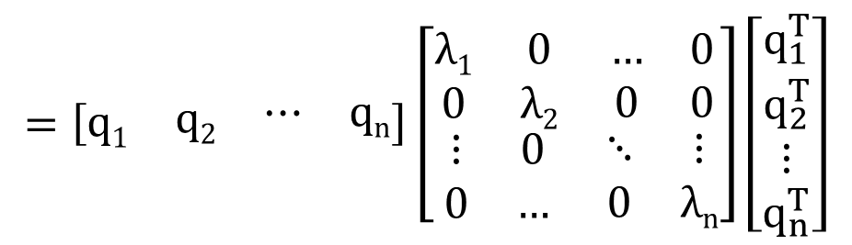

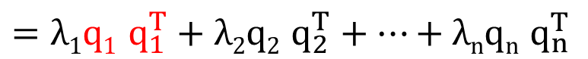
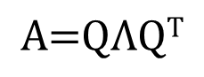
Projection onto eigenvector
If $A=A^{T}$, we can write:
$$\text{A}\text{=}\text{Q}\text{Λ}\text{Q}\text{T}$$
$$=\left[\begin{matrix}q1 & \begin{matrix}q2 & \begin{matrix}⋯ & qn\end{matrix}\end{matrix}\end{matrix}\right]\left[\begin{matrix}\begin{matrix}λ1 & 0 \\ 0 & λ2\end{matrix} & \begin{matrix}… & 0 \\ 0 & 0\end{matrix} \\ \begin{matrix}⋮ & 0 \\ 0 & …\end{matrix} & \begin{matrix}⋱ & ⋮ \\ 0 & λn\end{matrix}\end{matrix}\right]\left[\begin{matrix}q_{1}^{T} \\ q_{2}^{T} \\ \begin{matrix}⋮ \\ q_{n}^{T}\end{matrix}\end{matrix}\right]$$
$=λ1q1$ $q_{1}^{T}+λ2q2 q_{2}^{T}+…+λnqn q_{n}^{T}$
Projection matrix

Slide 9
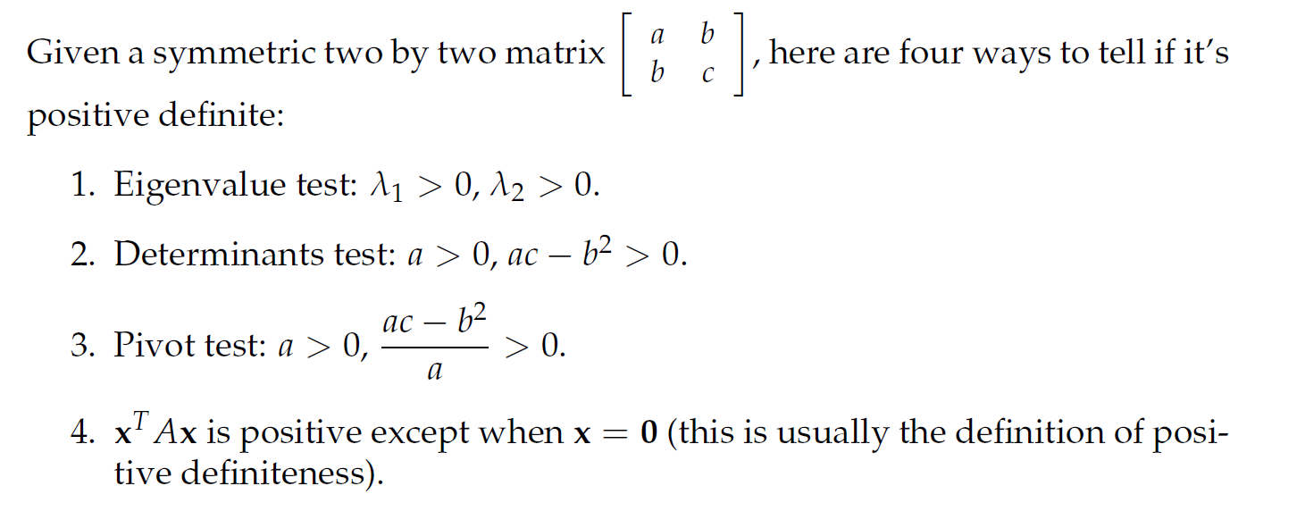
Positive definite matrices

Slide 10
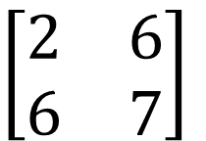
Example 1
$$\left[\begin{matrix}2 & 6 \\ 6 & 7\end{matrix}\right]$$
What is its geometric meaning ?

Slide 11
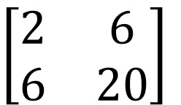
Example 2
$$\left[\begin{matrix}2 & 6 \\ 6 & 20\end{matrix}\right]$$
What is its geometric meaning ?

